Slide 1
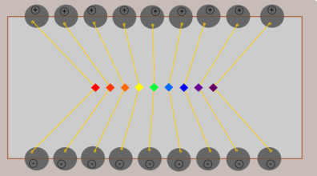
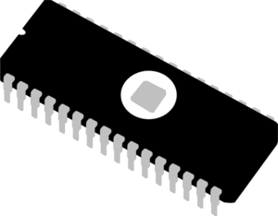
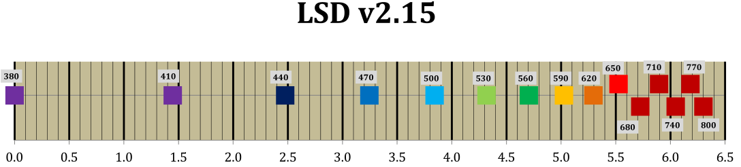
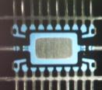
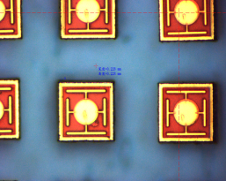
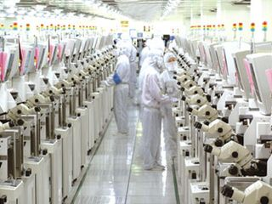
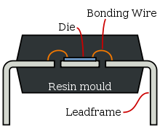
PROTO2013 – LSD 2.x
Lead Frame with
individual chip control
Chips 220x220µm
Side bounding
IC process

Slide 2

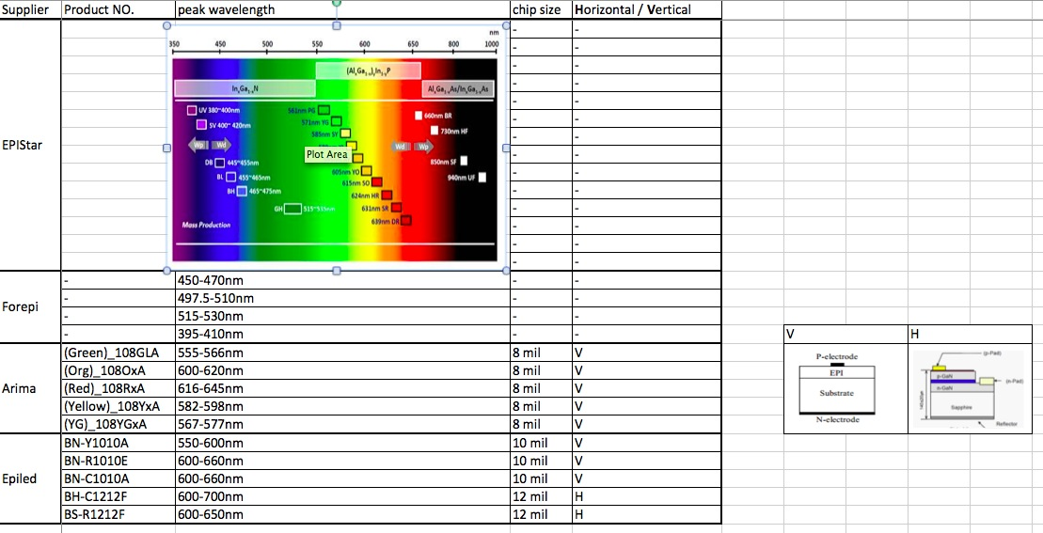
M1: Sourcing LSD
CSCO

Slide 3
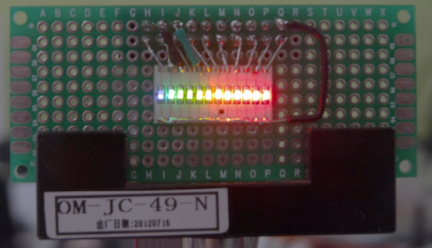
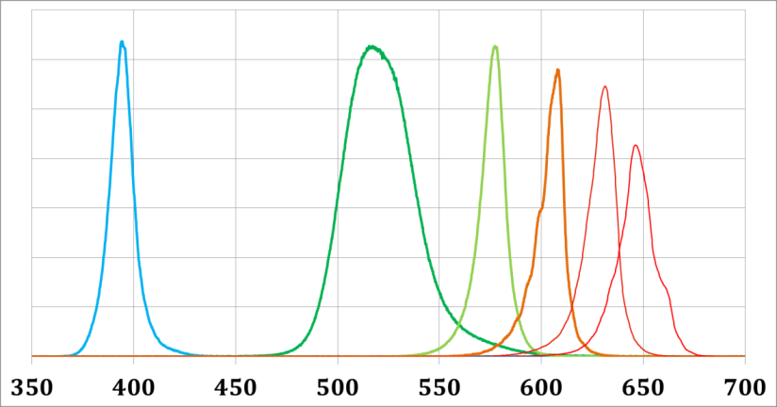
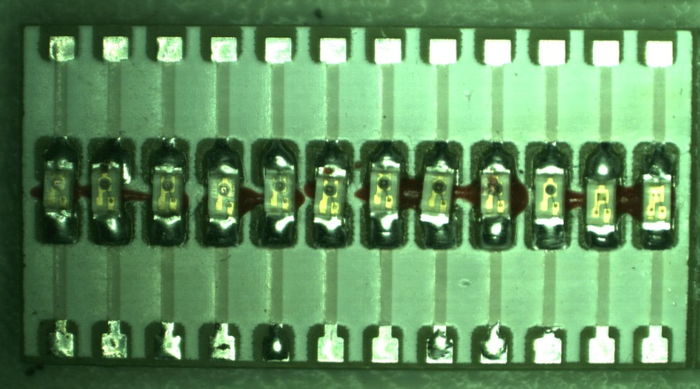
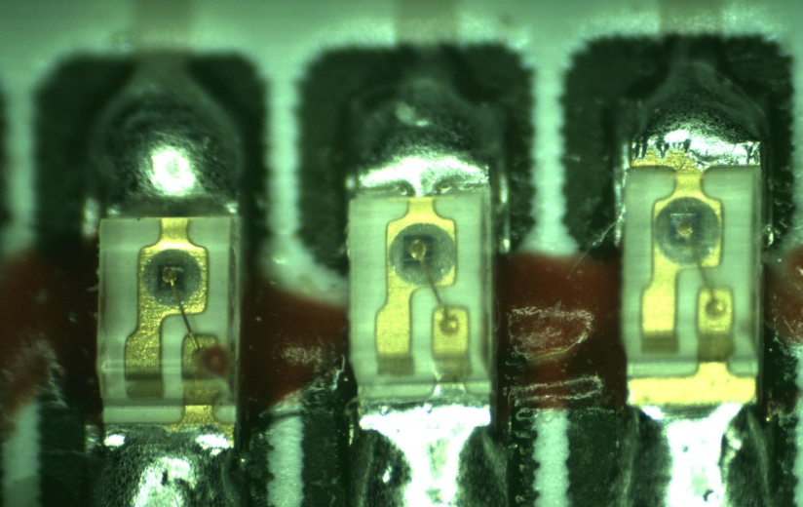
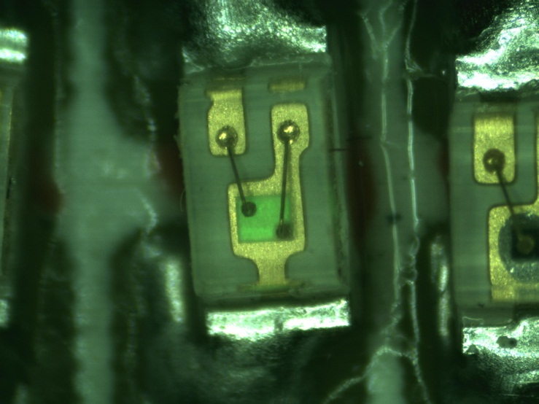
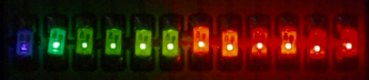
PROTO2012 - LSD (v1.12)
Simple concept
Easy production
Chip Spacing > 1mm
Repeatability
Low IP control
20mm
1.50 mm
250 µm

Slide 4
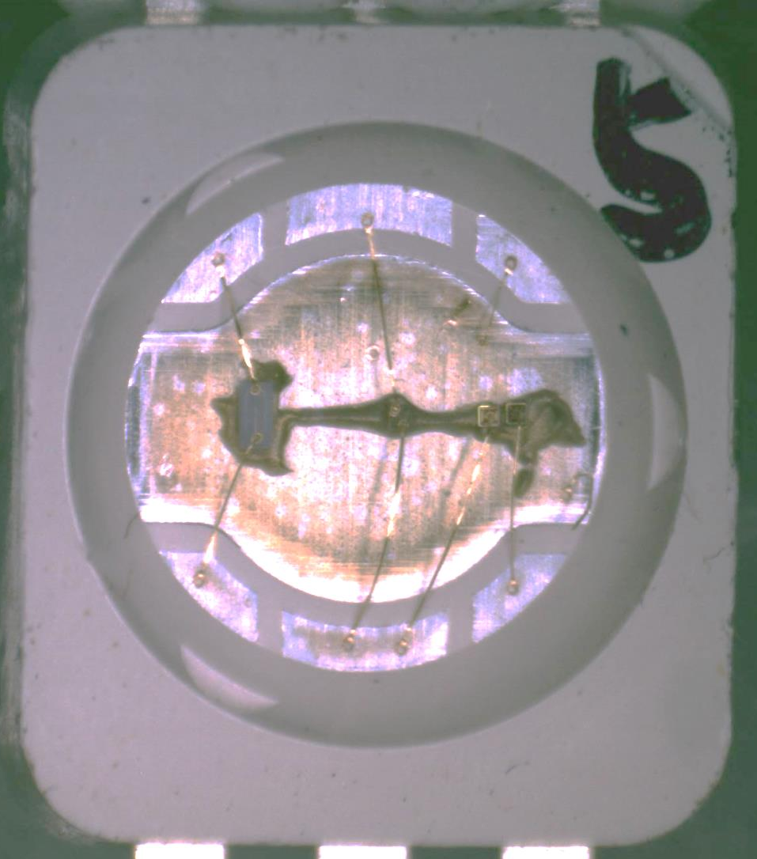
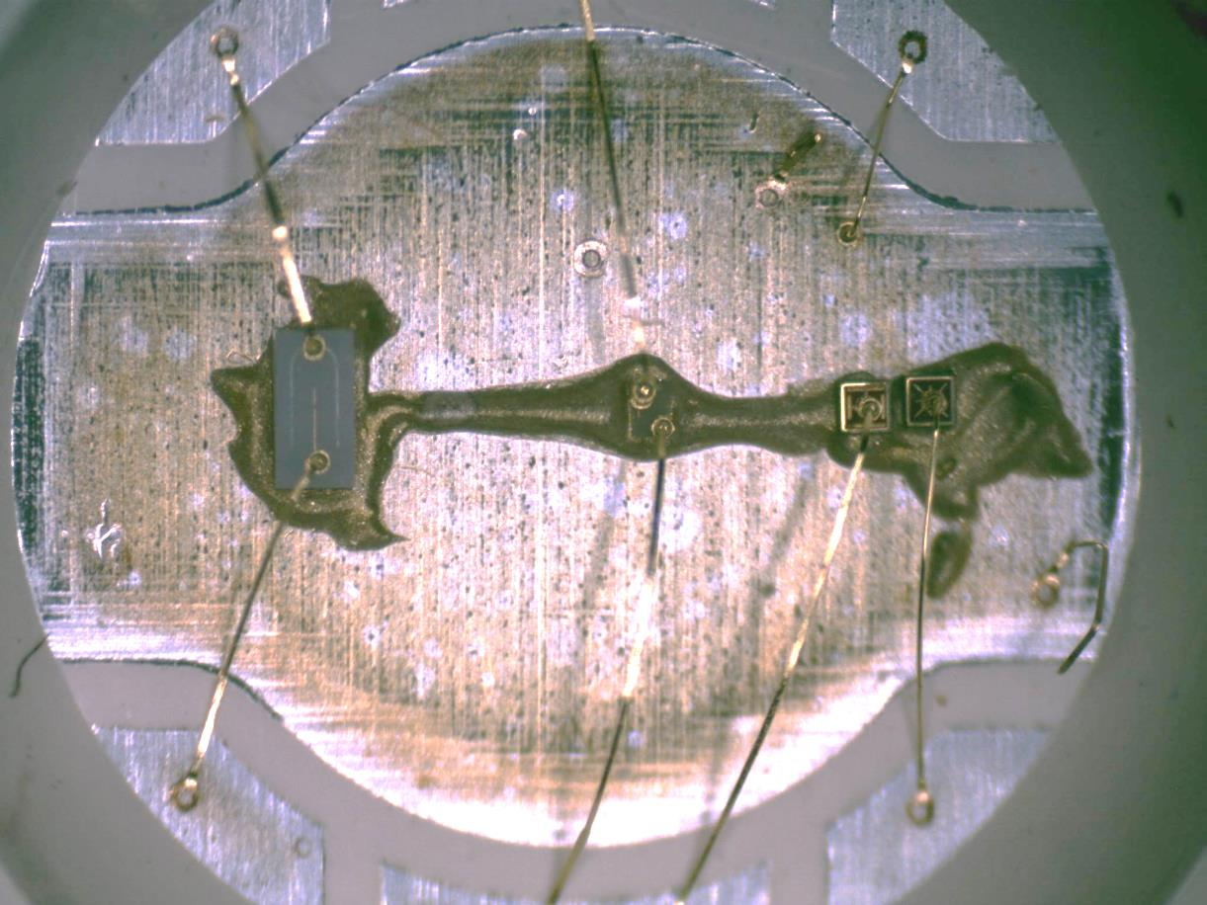
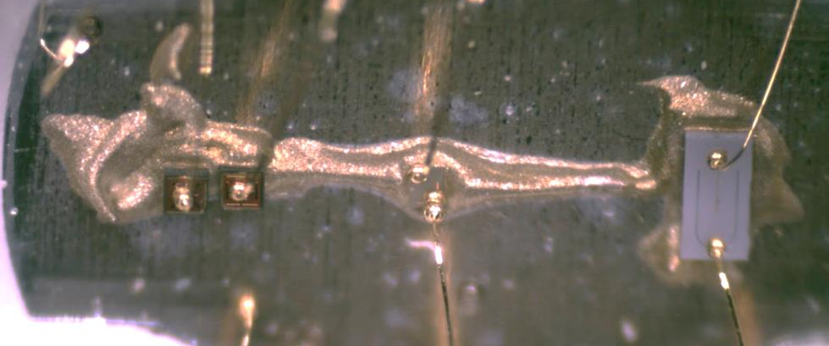
µLSD v2.4
0.42x0.75
0.22x0.22
0.22x0.22
0.22x0.22
5.2mm
5.2mm
7.6mm
λ [nm] | T [fs] | ν [THz] | E [eV] | σ [1/cm]
448 | 1.49 | 670 | 2.80 | 22 300
520 | 1.73 | 577 | 2.38 | 19 200
593 | 1.98 | 506 | 2.09 | 16 900
634 | 2.11 | 473 | 1.96 | 15 800
h≈0.22
Notes:
634nm 593nm 520nm 448nm

Slide 5
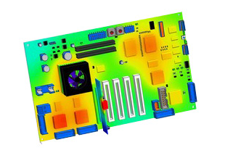
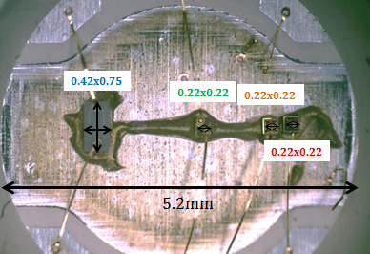
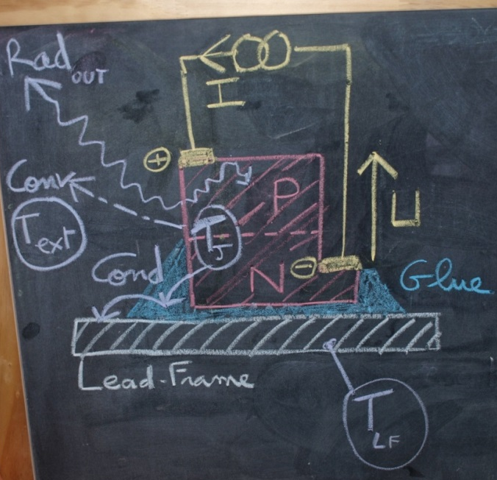
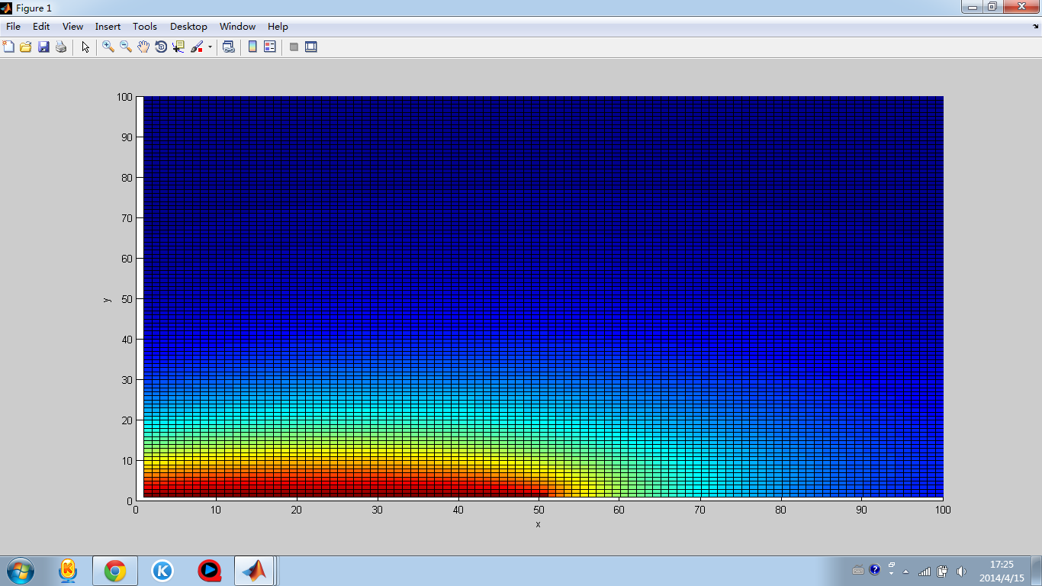
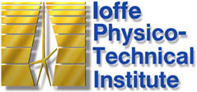
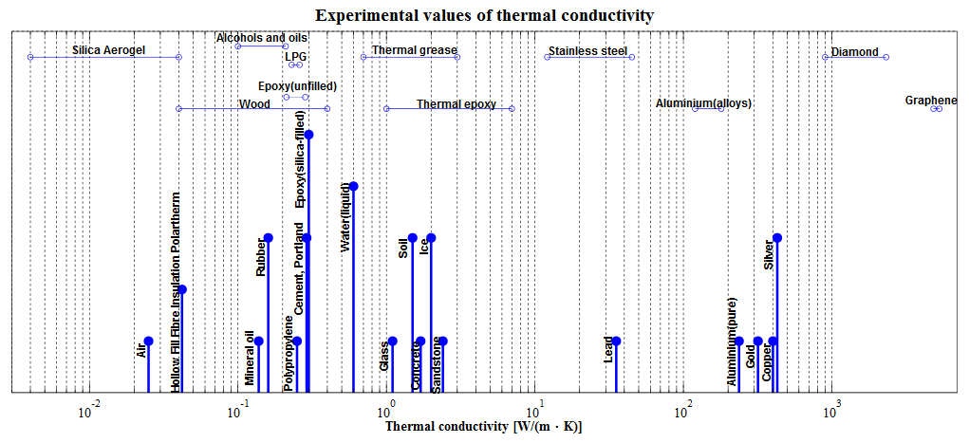
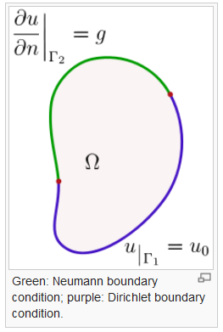
Uniform Cartesian Grid

Slide 6
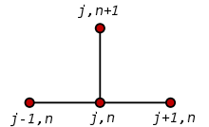

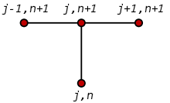
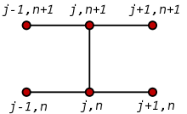
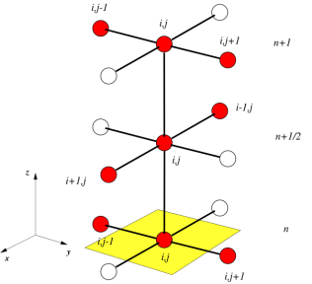
PDE Partial Differential Equation
http://en.wikipedia.org/wiki/Partial_differential_equation
FDM Finite Difference Method
http://en.wikipedia.org/wiki/Finite_difference_method
http://www.nada.kth.se/~jjalap/numme/FDheat.pdf
FTCS Forward-Time Central-Space (explicit method)
http://en.wikipedia.org/wiki/FTCS_scheme
CFL Courant–Friedrichs–Lewy condition
http://en.wikipedia.org/wiki/Courant-Friedrichs-Lewy_condition
Explicit vs Implicit methods…
http://en.wikipedia.org/wiki/Implicit_method
BTCS
Backward Time Centered Space
Crank–Nicolson
Central Time Centered Space
FEM pour DE
http://www.math.chalmers.se/~mohammad/teaching/PDEbok/Draft_I+II.pdf
ADI Alternating Direction Implicit method
http://en.wikipedia.org/wiki/Alternating_direction_implicit_method

Slide 7
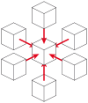

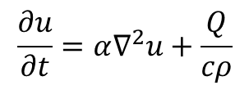
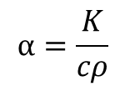
PPDE
$$\frac{∂u}{∂t}=α∇^{2}u+\frac{Q}{cρ}$$
$$u=u\left(\vec{r},t\right)$$
$$α=\frac{K}{cρ}$$
il existe un lien avec la mécanique quantique non-relativiste : l'équation de Schrödinger apparait en effet comme une équation de la chaleur en temps imaginaire
u(r, t) Temperature of the material at location r=(x,y,z) at time t
c(mat,u) Specific heat of material
Amount of heat [J] per unit mass [/g] necessary to raise the temperature of 1° [/K]
ρ(mat,u) Density of material
Mass [g] per unit volume [/mm3]
K(mat,u) Thermal conductivity of the material
Amount of power [W] per unit length [/cm] per degree [/K] the material can conduct
Q(r, t) Amount of heat [J] generated per unit volume [/mm3] per unit time [/s] at location r at time t
φ(r) Heat energy flux at location r
α Thermal diffusivity [mm²/s]
Notes:
[u(r+dx,t)+u(r-dx,t) + u(r+dy,t)+u(r-dy,t) + u(r+dz,t)-u(r-dz,t) -6u(r,t)]/dx

Slide 8
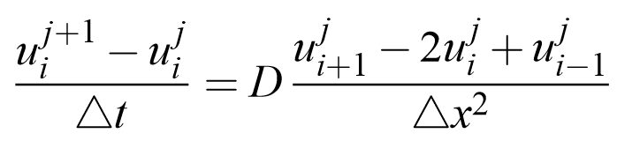

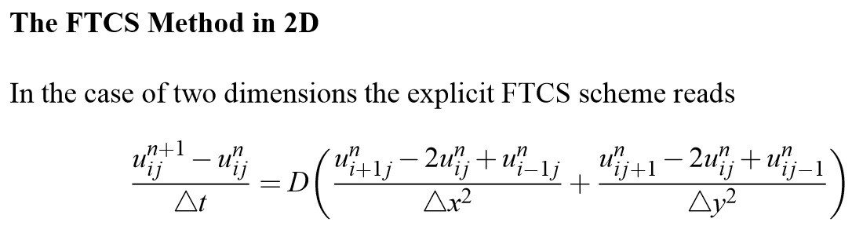


D.∆t < ∆$x^{2}$/6
[u(r+dx,t)+u(r-dx,t) + u(r+dy,t)+u(r-dy,t) + u(r+dz,t)-u(r-dz,t) -6u(r,t)]/dx³

Slide 9





$$u=u\left(\vec{r},t\right)$$
D.∆t < ∆x⁴/6
c(T).ρ(T).[u(r,t+∆t)-u(r,t)].∆V
K/dV x [u(r+dx,t)+u(r-dx,t)
+ u(r+dy,t)+u(r-dy,t)
+ u(r+dz,t)-u(r-dz,t)
-6u(r,t)]
K.grad[u(r,t)] }
Avec grad[u(r,t)] = u(r)
u
u

Slide 10
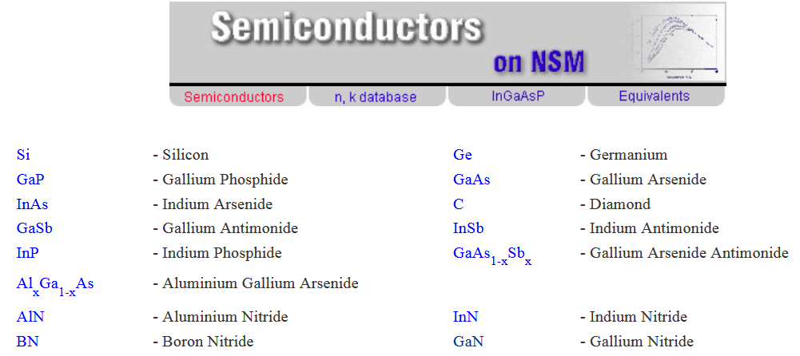
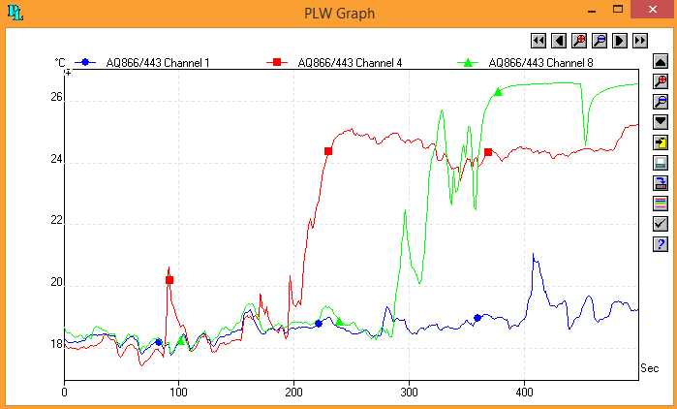
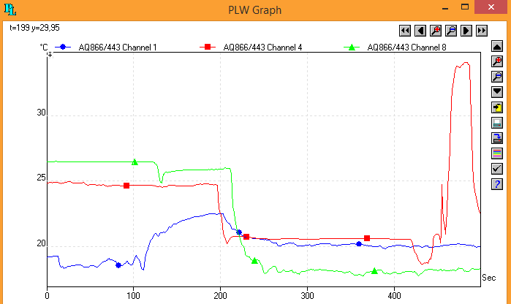
http://www.ioffe.ru/SVA/NSM/Semicond/

Slide 11
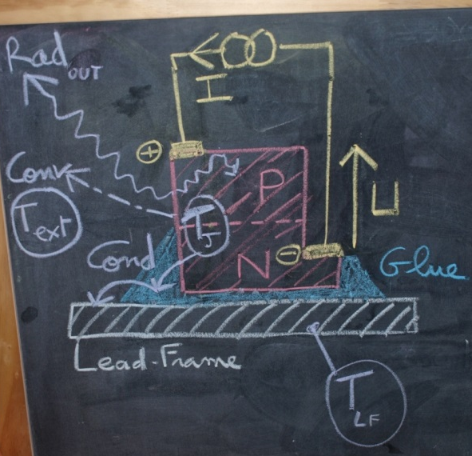
τ_Th ~1 – 0,1 ms
ΔT/Δt = 0,01 – 0,1 °C /ms

Slide 12
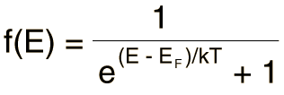
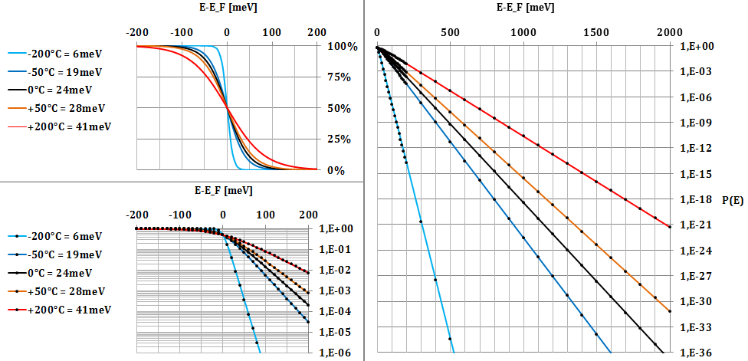
Le model de la Jonction PN: Fermi-Dirac Distribution

Slide 13
